Slide 1

SQL Injection

Slide 2

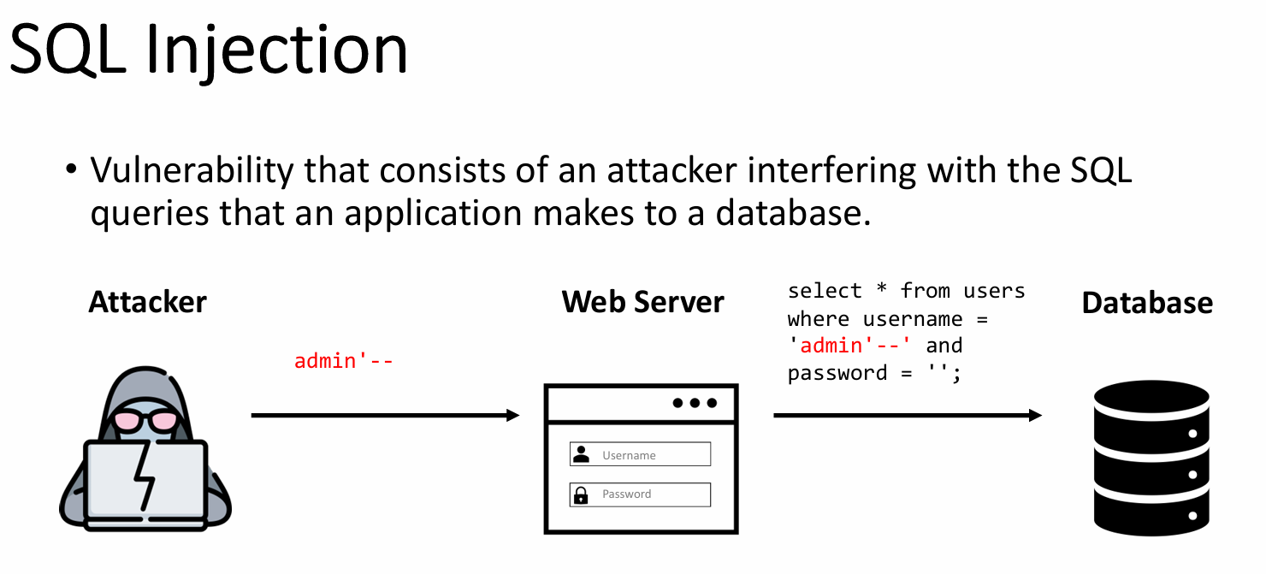
SQL Injection

Slide 3
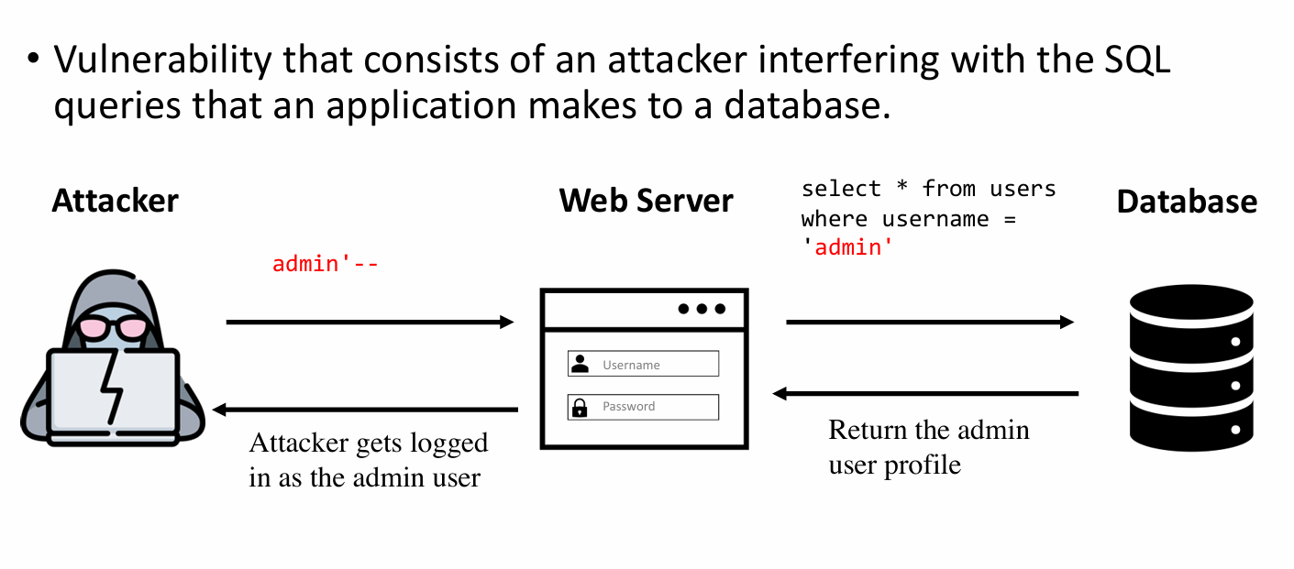
SQL Injection

Slide 4
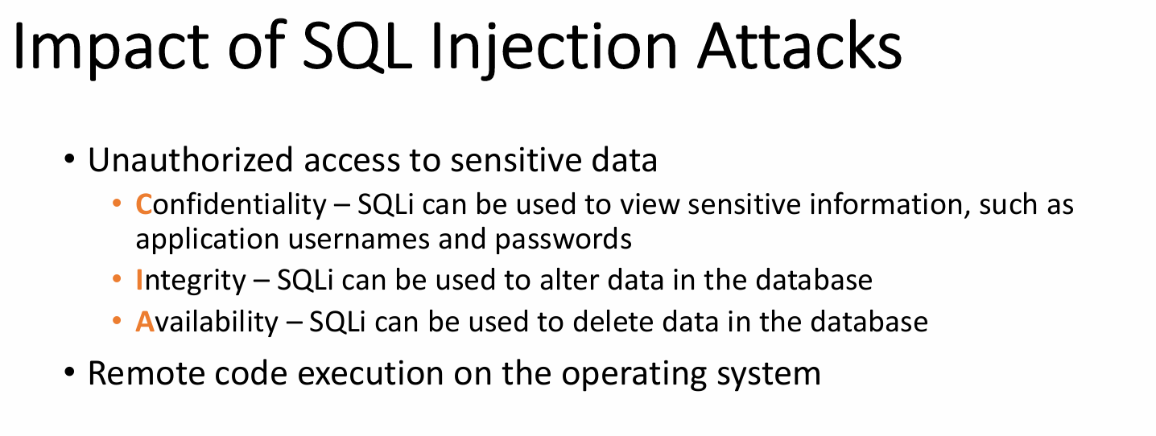
SQL Injection

Slide 5
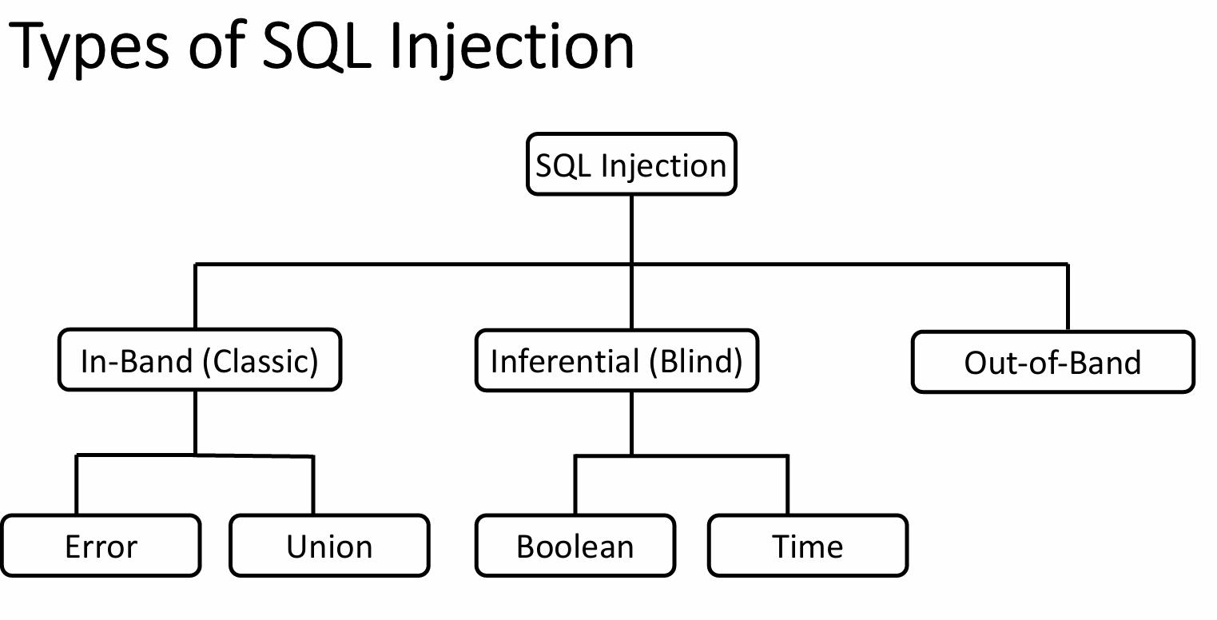
SQL Injection

Slide 6
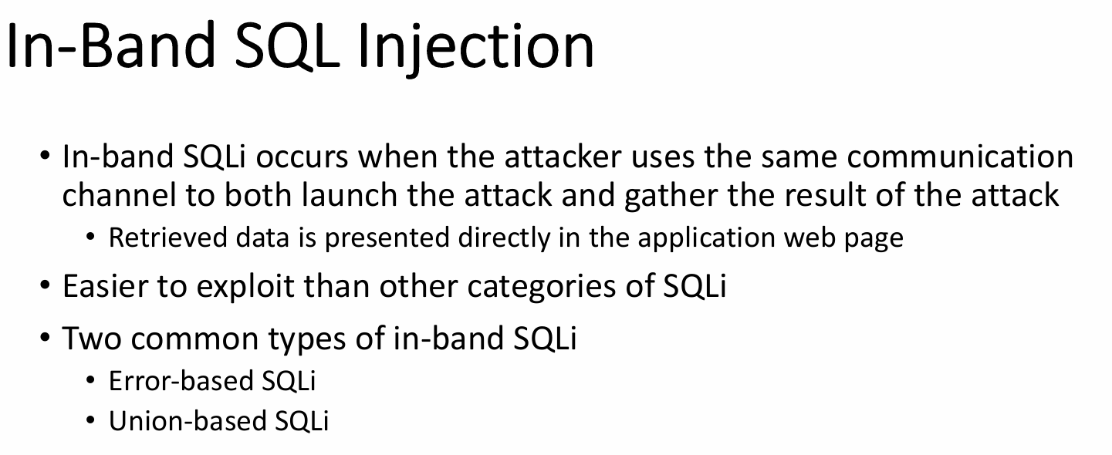
SQL Injection

Slide 7
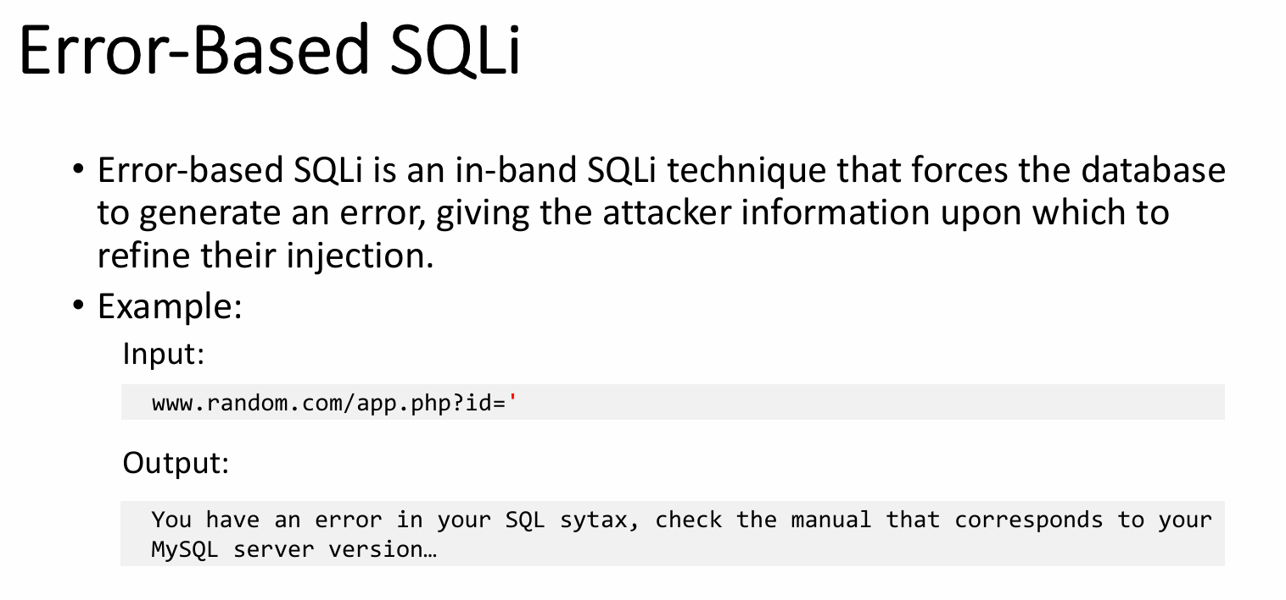
SQL Injection

Slide 8
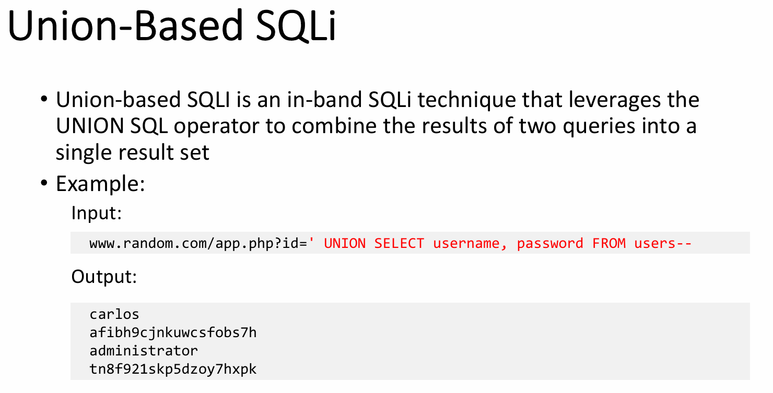
SQL Injection

Slide 9
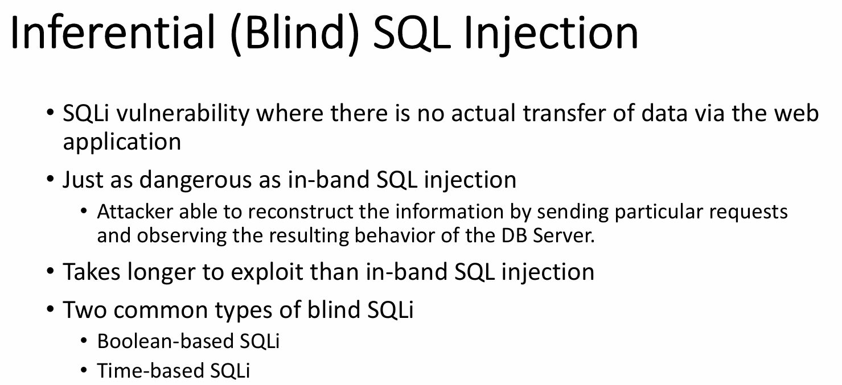
SQL Injection

Slide 10
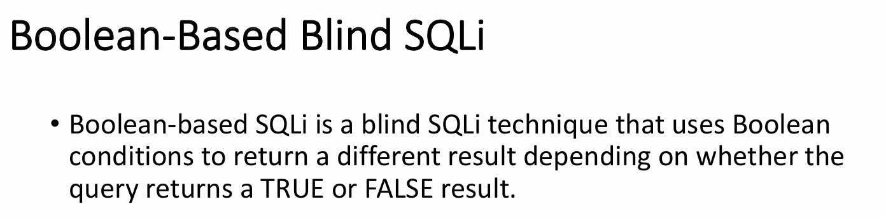
SQL Injection

Slide 11
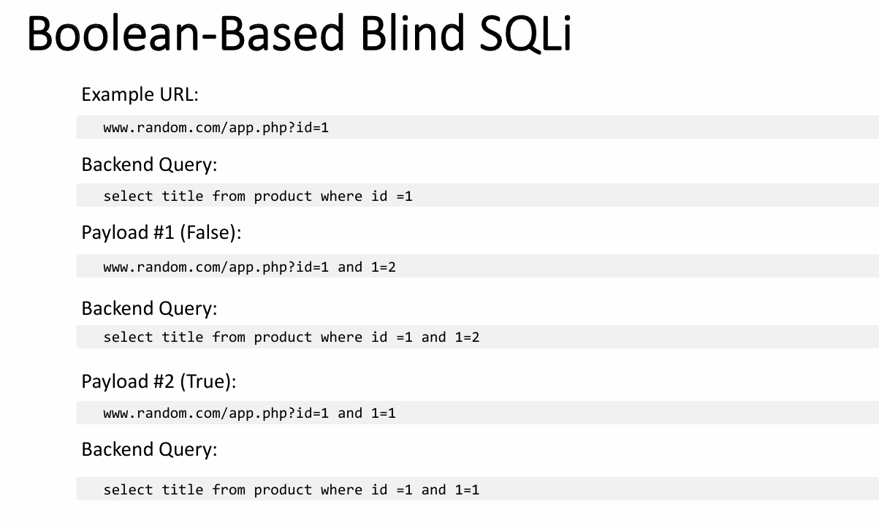
SQL Injection

Slide 12
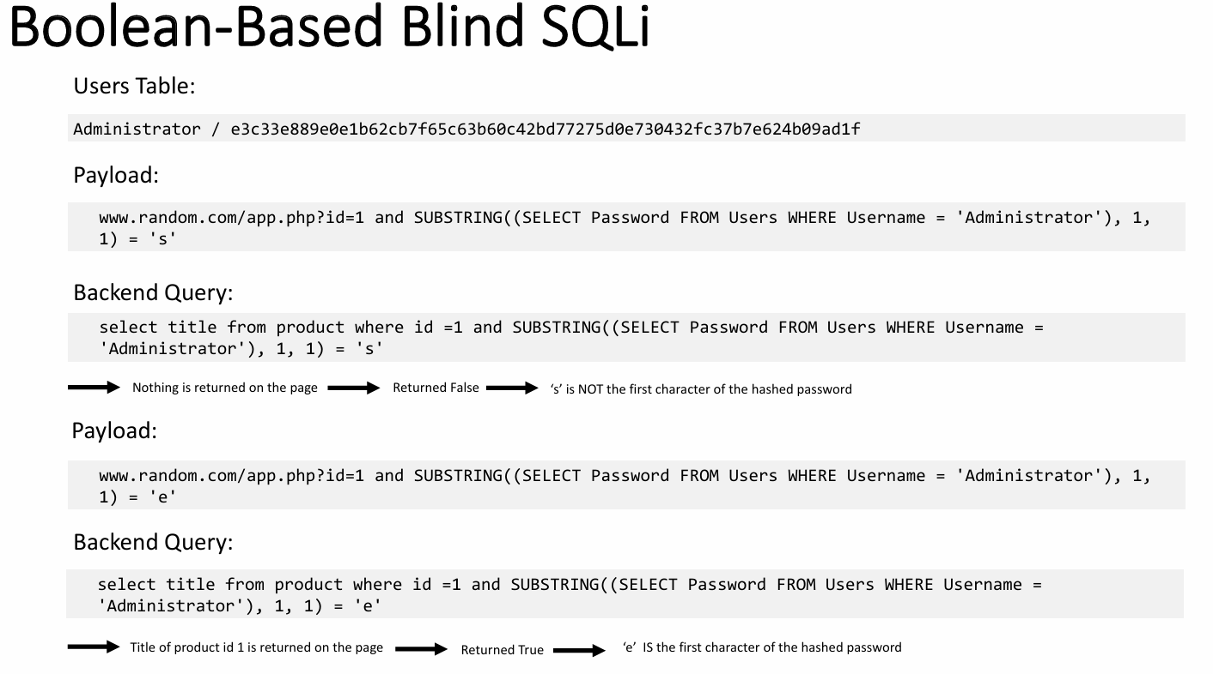
SQL Injection

Slide 13
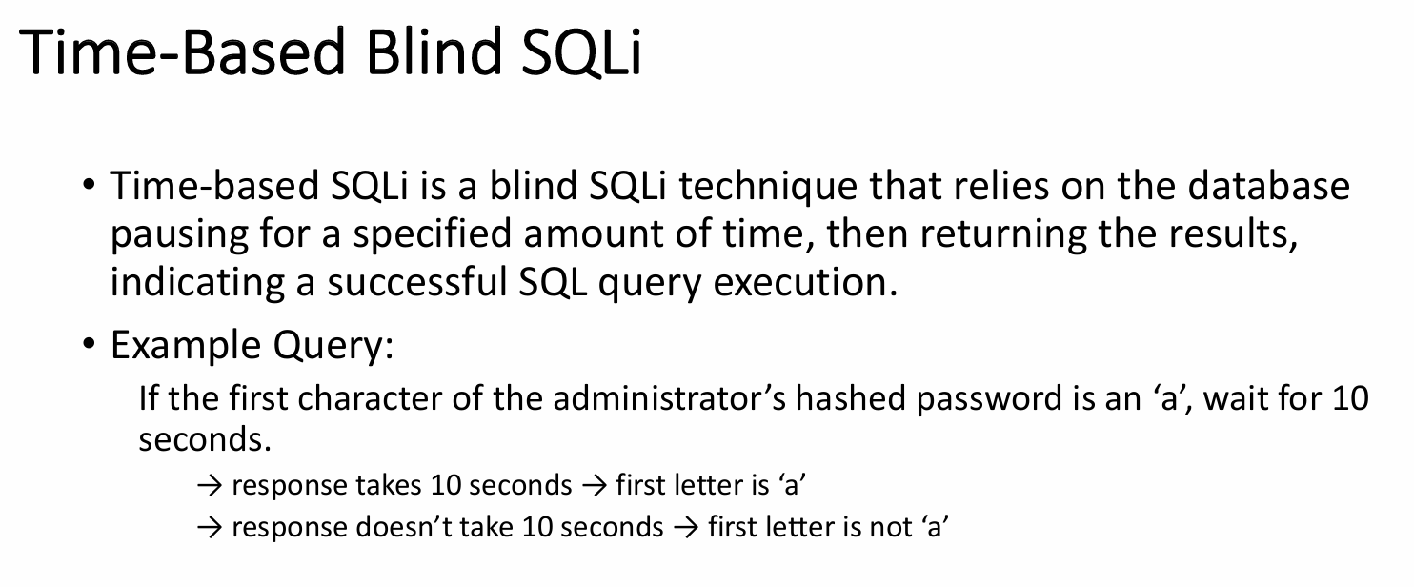
SQL Injection

Slide 14
03
THANK YOU

